Slide 1

Alcon: Automated Particulate Counting Handpiece Production
Team:
Isaac Hoyt, Brian Ngo, Matthew Luong, Yolanda Gomez, Tandol Jerthsattayanukul, Landon Stein.
Mentors:
Tom Schacht (Sr. Manager Manufacturing Engineering),
Diego Cueto (Head of Manufacturing)

Slide 2
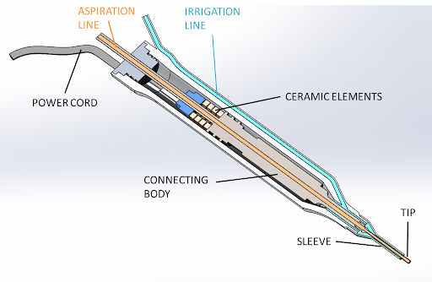
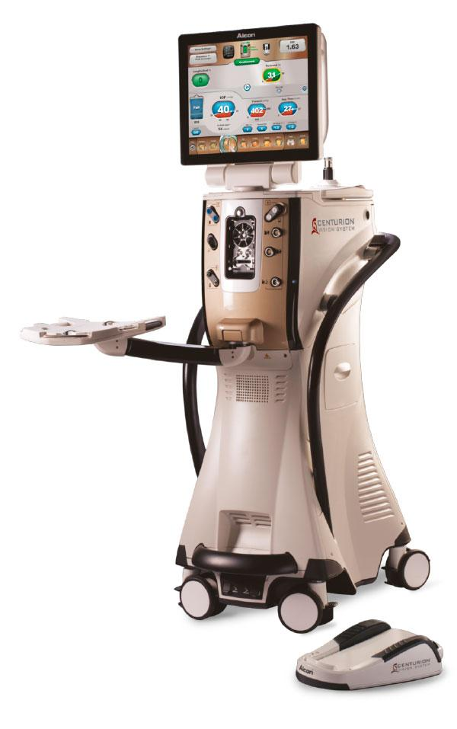
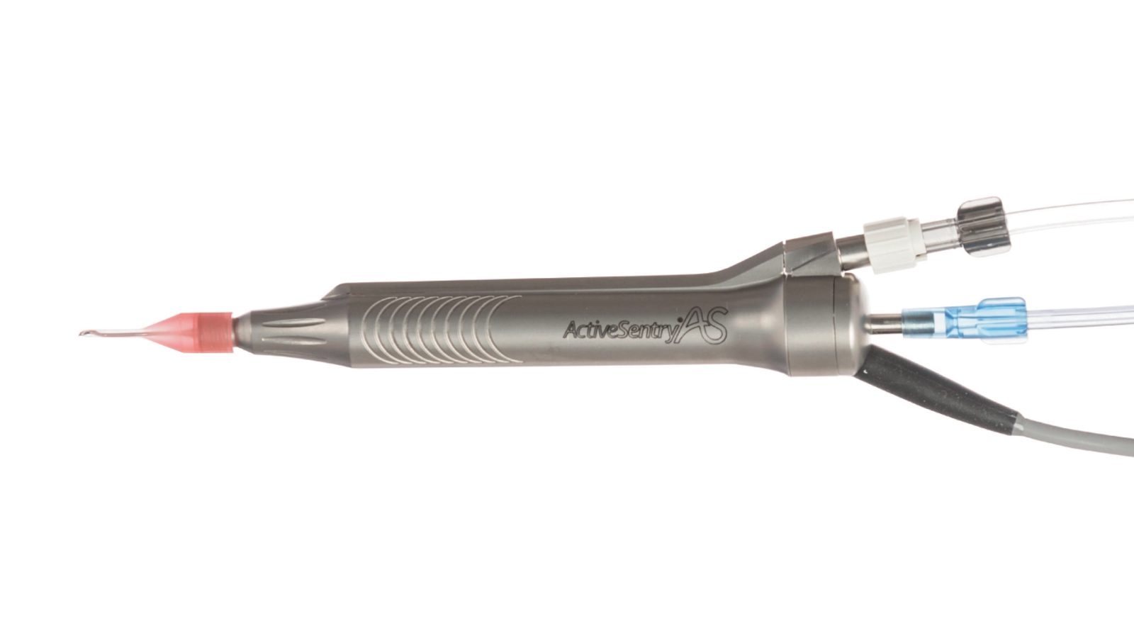
ACTIVE SENTRY®
Handpiece
Component of CENTURION® Vision System
http://www.surgicaldesign.com/thefutureofphaco.php
https://theophthalmologist.com/subspecialties/taking-the-pressure-off
Notes:
matthew

Slide 3

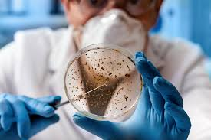
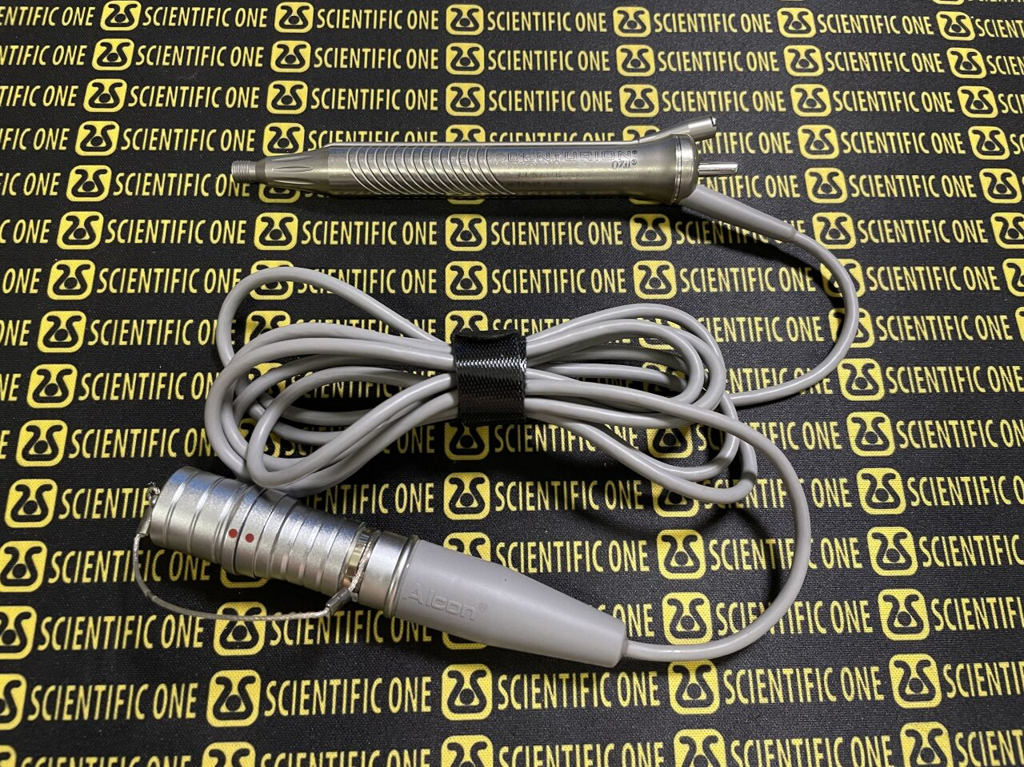
Problem
Surgical
Manufacturing
During manufacturing and surgical processes, particles infiltrate.
Particulate counting is tedious, time consuming, and prone to human error.
[1]
https://www.vasanhealthcare.lk/vasan-blogs/clearing-the-mist-on-your-eye-what-is-cataract-surgery/
https://www.dotmed.com/listing/phacoemulsifier/alcon/centurion-ozil-handpiece-8065751761/4385298
https://ckgroup.co.uk/candidate/job-profiles/microbiologist-job-profile/
Notes:
Yolanda Cite:
[1] https://www.vasanhealthcare.lk/vasan-blogs/clearing-the-mist-on-your-eye-what-is-cataract-surgery/
[2] https://www.dotmed.com/listing/phacoemulsifier/alcon/centurion-ozil-handpiece-8065751761/4385298
[3] https://ckgroup.co.uk/candidate/job-profiles/microbiologist-job-profile/

Slide 4

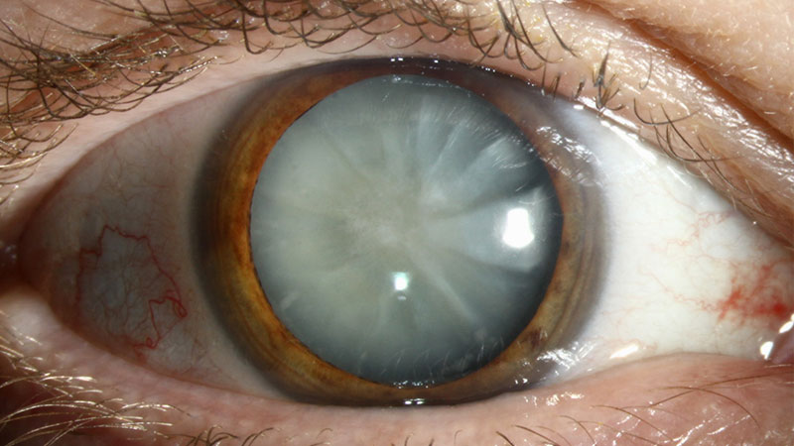
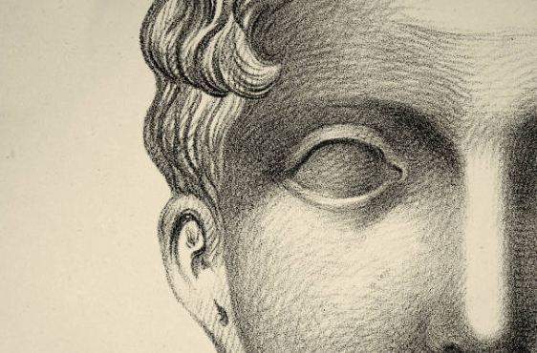
28
Million
https://www.gettyimages.com/illustrations/face-blindness?family=creative
https://www.vecteezy.com/vector-art/2637746-blind-disabled-man
https://insighteye.com.au/different-types-cataracts/
Cataract surgeries performed worldwide
Notes:
Yolanda Cite: [4] https://www.gettyimages.com/illustrations/face-blindness?family=creative
[5] https://www.vecteezy.com/vector-art/2637746-blind-disabled-man
[6] https://insighteye.com.au/different-types-cataracts/

Slide 5



Stakeholders?
Gap?
Patients
Surgeons
Manufacturers
Inefficient methods for particulate counting in handpiece manufacturing
https://www.istockphoto.com/photos/slow-progress
https://www.pekoprecision.com/blog/medical-device-manufacturing-critical-processes/
https://www.istockphoto.com/photos/eye-doctor-and-patient
Notes:
Yolanda
Cite:
[7] https://www.istockphoto.com/photos/slow-progress
[8] https://www.pekoprecision.com/blog/medical-device-manufacturing-critical-processes/
[9] https://www.istockphoto.com/photos/eye-doctor-and-patient

Slide 6
Design criteria
Manufacturing Quality Testing Device – Quickly evaluates particulate count with accurate and precise measurements. Will integrate imaging technologies into device to perform counting process.
Criteria
Automatic Counting, decreases time to perform particulate counting process
Accurate, will be more accurate than the predicate
Cheaper, device should be cheaper than predicate
Possible Standards: USP 788, IEC 62304, ISO 16232, ISO 10993-15,
Acceptance Criteria: more accurate and equivalent time OR faster with equivalent accuracy
Form-Factor: should not be larger than predicate device
Notes:
Criteria are based on engineering mentor input, existing product specifications, and background research.
788 – particulate matter in injections
62304 – software life cycles processes
16232 - Cleanliness of components and systems
10993 – Identification and quantification of
degradation products from metals and alloys

Slide 7
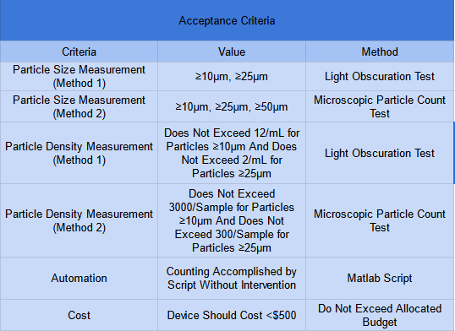
Design criteria
https://www.eurofins.com/medical-device/testing/chemicalphysical-analysis/particulate-matter/
USP 788

Slide 8
USP <788>: Particulate Matter in Injections
Method 2: Microscopic Particle Count Test
Method 1: Light Obscuration Particle Count Test
The principle of light blockage enables the automatic determination of particle size and number
Manual particle counting and sizing via microscope inspection of a dry membrane filter
Notes:
Tandol Mathew

Slide 9
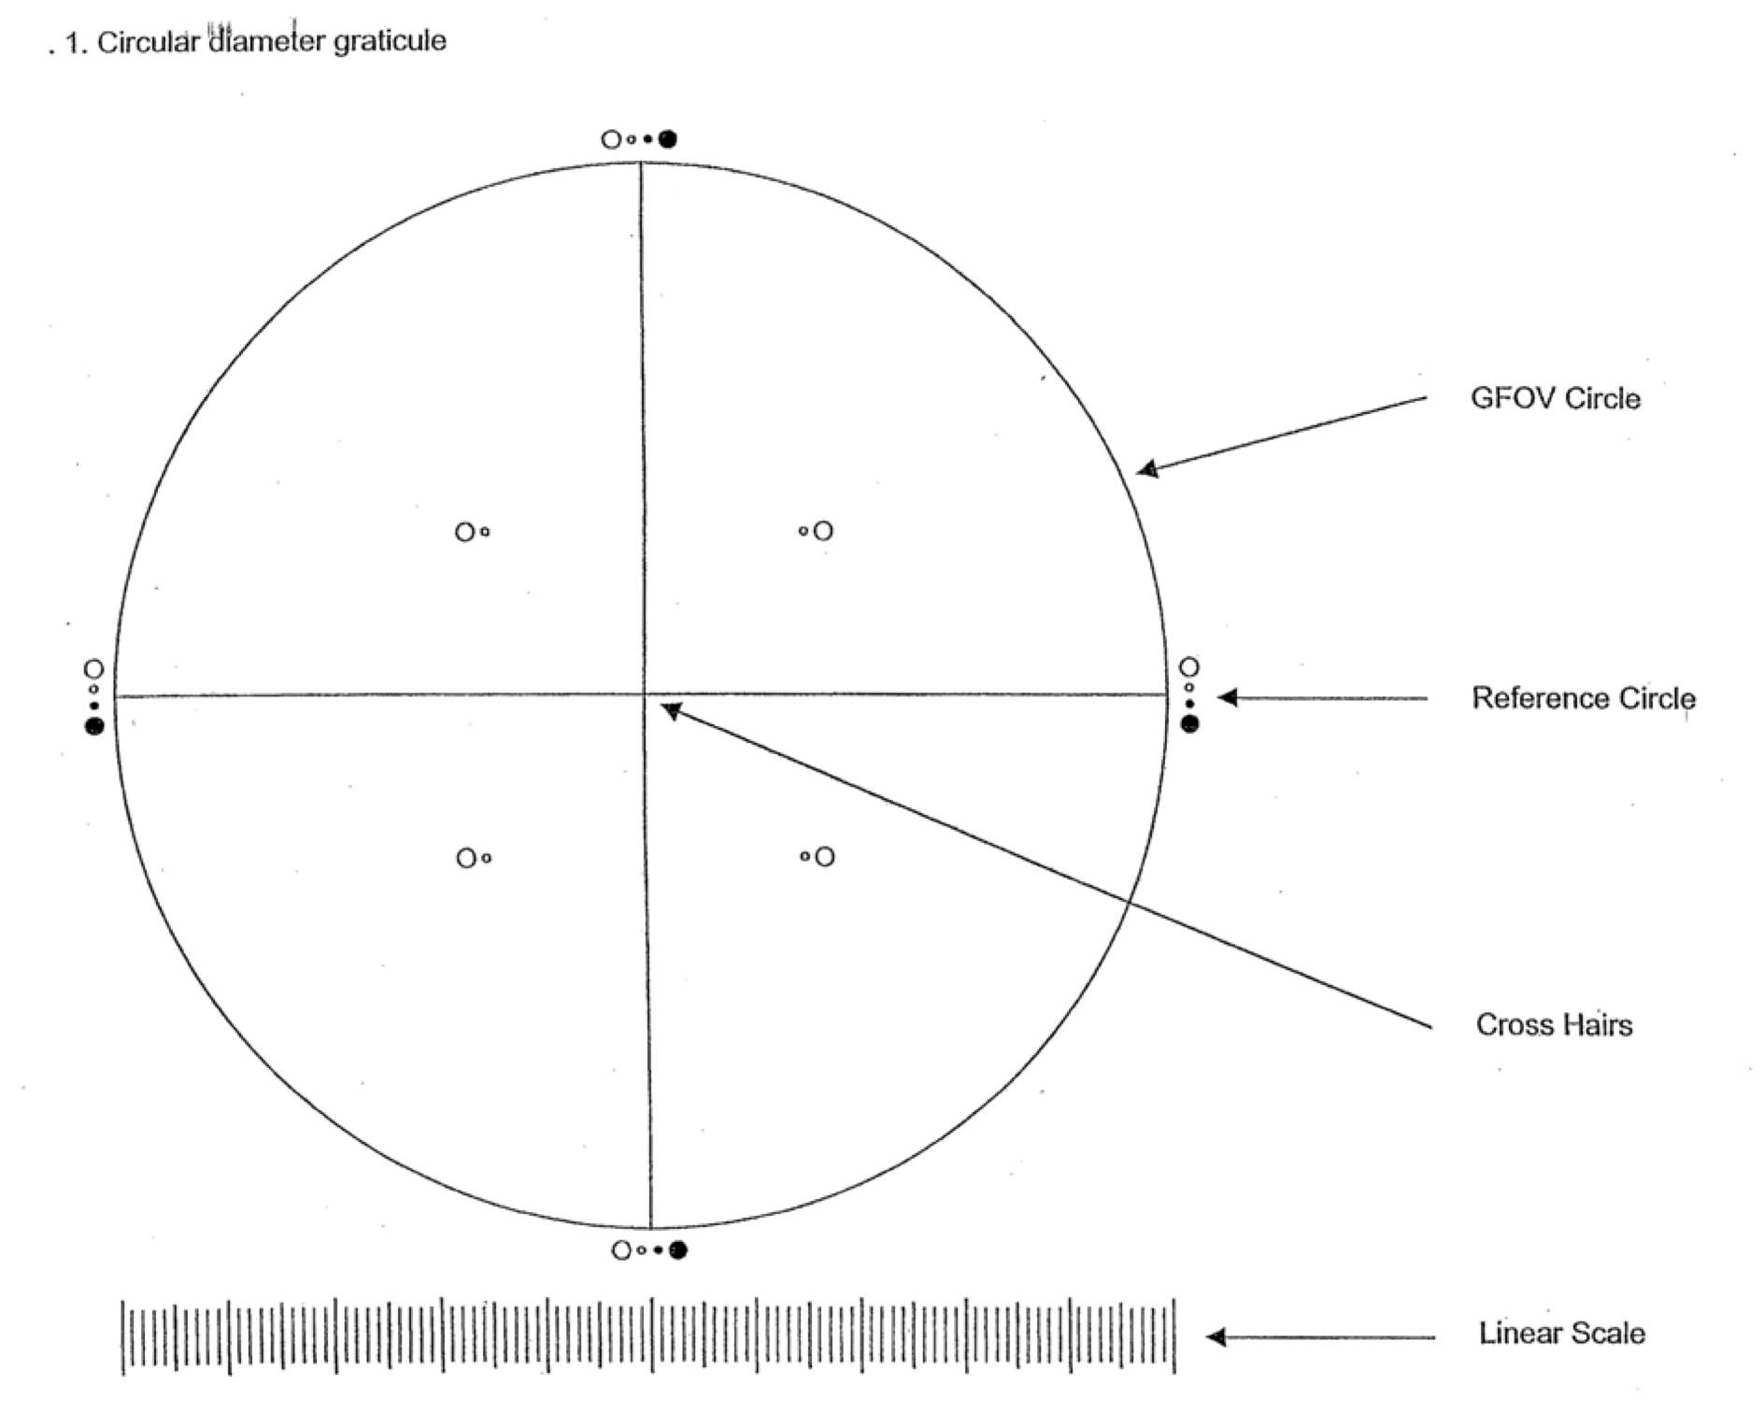
Improving the Microscopic Particle Count Test
Dry visual filter analysis
Technicians count the particles manually
Automated visual inspection
Microscope equipped with high-resolution camera to capture detailed images of filter surface
Automated system utilize image analysis software to detect, count, and categorize particle based on size and shape
https://www.uspnf.com/sites/default/files/usp_pdf/EN/USPNF/revisionGeneralChapter788.pdf
Notes:
Tandol Mathew

Slide 10
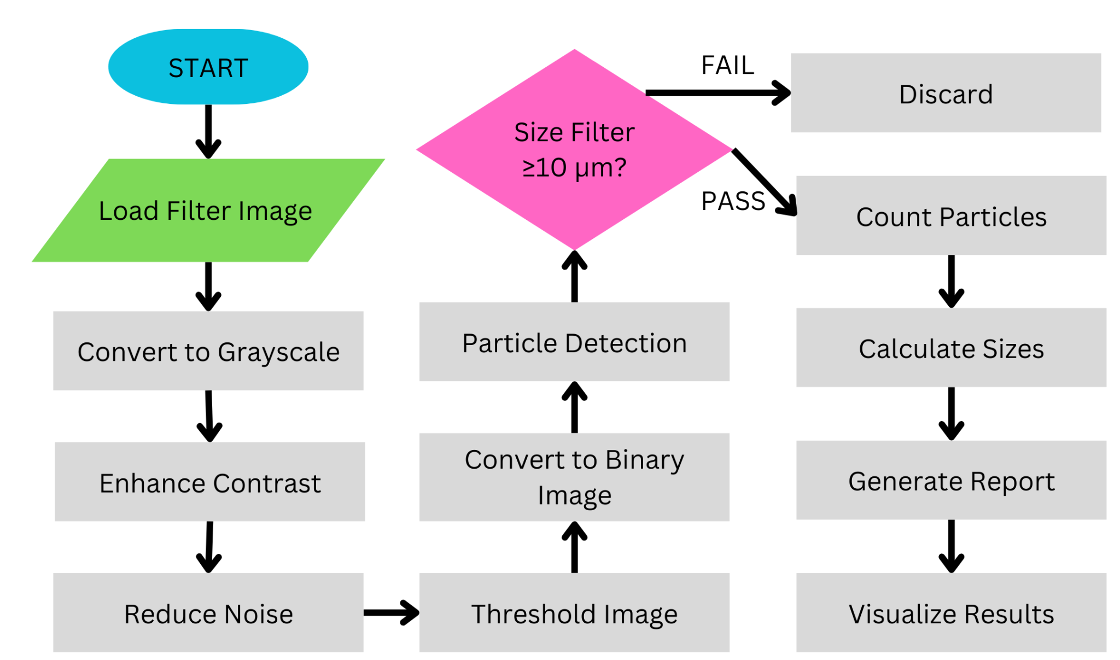
MATLAB Workflow

Slide 11
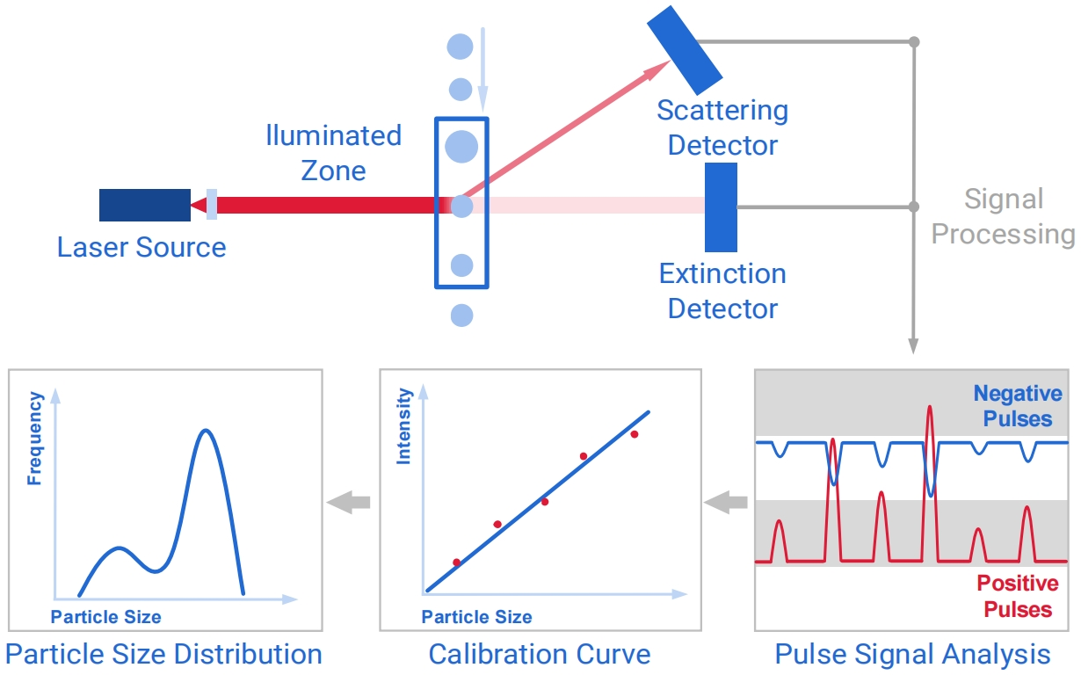
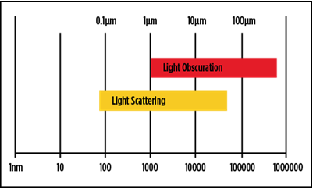
Light Obscuration Particulate Counting
Single Particle Optical Sensing (SPOS)
Particles suspended in liquid sample create “shadows” when passing between laser and detector
Measures light intensity reduction
Easily to automate and calibrate
https://www.beckman.com/resources/industry-standards/usp-787/light-obscuration-optical-method-for-particle-detection
https://www.bettersizeinstruments.com/learn/bettersize-wiki/measure-the-particle-size-with-the-optical-particle-counter/

Slide 12
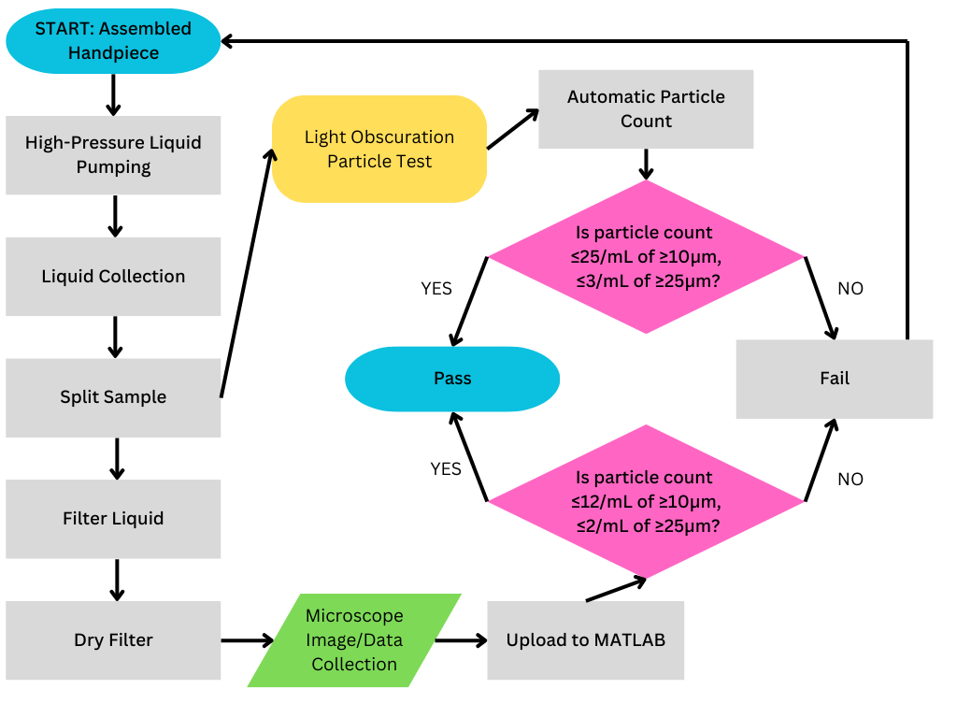
Process Flowchart

Slide 13



Our team
Isaac Hoyt
Landon Stein
Brian Ngo
- Leading the team
- Ensuring deadlines are met
- Keeping progress on track and on time.
- Maintaining communication with engineering mentors
- Developing test protocols
- Verifying design choices
- Ensuring design choices align with device intentions
- Advising the team in conducting business in conjunction with Alcon
- Providing insight into the utilization of the device
Notes:
Brian

Slide 14



Our team
Yolanda Gomez
Tandol Mathew Jerthsattayanukul
Matthew Luong
- Working with hardware and manufacturing
- Ensuring the production of the device gets off the ground.
Shared Responsibility:
- Developing and revising the prototype
- Confirming changes are effective and well-documented.
- Working with hardware and manufacturing
- Ensuring the production of the device gets off the ground.
Notes:
Brian

Slide 15
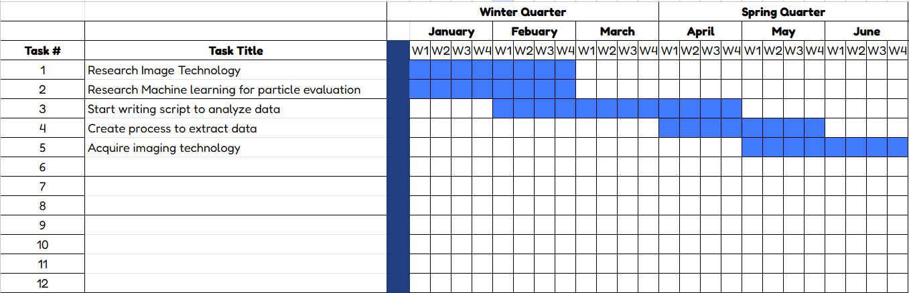
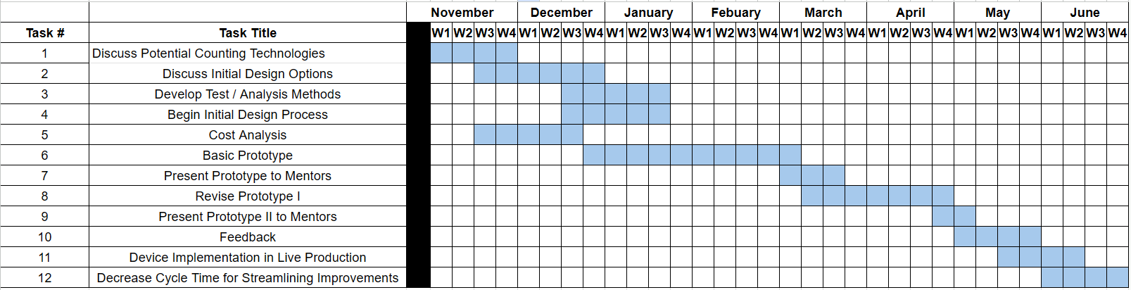
Future Goals
Future Goals
Notes:
Brian
Research Image Technology: Investigate existing imaging technologies to determine which is best suited for capturing particulate matter from the Active Sentry Handpieces. This involves exploring methods like HD optics, white-light interferometry, SEM-EDX, and FTIR to ensure precision in detecting and analyzing particles.
Research Machine learning for particle evaluation: Explore how machine learning can be used to analyze images of particulate matter, focusing on classifying particles based on size, shape, and density. This step will involve identifying algorithms that can provide consistent and reliable results.
Start writing script to analyze data: Begin developing a MATLAB script or similar computational tool to process images and extract relevant data. This script will automate the counting, categorization, and evaluation of particles based on predetermined parameters.
Create process to extract data: Develop a streamlined method to transfer and analyze imaging data. This includes defining a workflow for capturing images, uploading them into the analysis software, and outputting results that align with the project’s quality control standards.
Acquire imaging technology: Procure the chosen imaging technology, ensuring it meets the required specifications for resolution, accuracy, and integration into the testing process. This step is essential for validating and implementing the research findings.

Slide 16
Thanks!

